Slide 1
Project – Exam Simulator
Project Purpose : To build a robust system that to simulate and fetch questions from database.
Project Guidance by: Mr .Raju GMK
Project word load distribution:
Team Size: 10
SI No | Name | Staff No | Designation | Role | Activity
1 | Sandhya P | 83008568 | GAPP | SW Developer | Project workout plan, Class Diagram, Final Validation, Project Presentation
2 | N Vani | 83008980 | GAPP | SW Developer | Project Abstract , Design approach, Use Case Diagram, Test Plan, Software Framework analysis
3 | Parvathi B | 83008112 | GAPP | SW Developer | Requirement Analysis, Flowchart, Design Aspects, Source code
4 | Anand Meti | 83008505 | GAPP | SW Developer | Work Environment, Release and Deployment, Project Integration
5 | Veeresh Patil G B | 83008521 | GAPP | SW Developer | Project Deployment , Lesson Learnt Logs , Project Presentation
6 | Bhavana H N | 83008560 | GAPP | SW Developer | Activity diagram, Best Practices, Unit Test Cases
7 | Bindhu H S | 83008544 | GAPP | SW Developer | Sequence Diagram, Risk Log Updated, Issues Log Updates , Functional Qualification Testing

Slide 2
Project Domain & Technology Stack
Domain:
JAVA Application Version_1.0, dated 28 Nov 25
Technology Stack :
Operating System: Windows 10/11
Programming Language: JAVA (Version 17.0.11)
Frontend: Java Swing (Version 17.0.11)
Backend: JAVA(Version 17.0.11)
IDE: IntelliJ IDEA (Version 21.0.7)
Database: PostgreSQL (Version 9.6)
Data Interchange: Microsoft Excel 2010

Slide 3
Project Abstract
The “Exam Simulator” project delivers a simulator dynamically generate and present multiple-choice questions. Content is efficiently imported from Excel Sheets, enabling question bank updates without code modification. The system provides immediate feedback, offering a cost-effective and accessible learning tool for examiners, with a scalable database structure.

Slide 4
Introduction to the Project (Project Overview)
This project develops a dynamic exam simulator designed to help users practice examination concepts. It efficiently loads question and answer data from Excel spreadsheets into a PostgreSQL database, forming a comprehensive question bank for multiple-choice quizzes. A user-friendly interface displays these questions, This simulator provides a cost-effective and adaptable tool for learning and assessment, leveraging the power of a efficient database and intuitive user experience.
Key features:
Dynamic Question Delivery: Generates quizzes from database, offering varied and non-repetitive practice.
Excel-Based Content Management: Enables easy updating of questions and answers via Excel spreadsheets
Scalable Database Structure: Built on PostgreSQL database, allowing for future expansion, personalized learning, and increased question volume.

Slide 5
Project Timelines
Requirement Gathering (08 Oct 2025 –08 Oct 2025)
Planning (08 Oct 2025 – 08 Oct 2025)
Design (09 Oct 2025 – 09 Oct 2025)
Implementation (04 Nov 2025)
Testing (18 Nov 2025)
Release & Deployment (24 Nov 2025)

Slide 6
Project Requirements
Login UI (REQ_01)
login page is displayed.
Admin login /Student login (REQ_02)
Enter the valid username and password.
For student login Select exam type (training or exam mode) Login to take the assessment.
For admin login , admin can upload the excel file
Uploading excel file to DB (REQ_03)
The admin browses the excel file.
Checks for DB connection and validates the file.
Question Presentation (REQ_04)
Questions are fetched from DB and displayed In the UI.
Answer Selection (REQ_05)
In training mode if user selects an option ,explanation is displayed.
In exam mode , the user takes the assessment.
Navigation Control (REQ_06)
The first and last buttons navigate to first and last question respectively.
The middle buttons navigate to previous or next question.
Feedback Display(REQ_07)
When user select submit button the result panel will display

Slide 7
Project Design Aspects
Design aspects associated with Exam Simulator :
Flow Chart
Activity Diagram
Use Case Diagram
Class Diagram
Sequence Diagram

Slide 8
Flowchart
Start
Invoke Application
Check Application Status
No
Yes
Display User Login
Admin Login
Student Login
Admin UI
Student UI
Question Presentation
Establish DB connection
Report Error
No
Answer Selection
If connection established
Yes
Navigate to next Question
Uploading Excel file to DB
If questions completed
No
Yes
End
Feedback Display

Slide 9
Activity Diagram
Start
DGN_01
User login
Step 1
DGN_02
DGN_02
Student login
Admin login
Step 2
Step 7
Admin UI display
Step 3
Step 8
Student UI display
DGN_03
Uploading
excel file to DB
Step 4
Training mode
Exam mode
Step 9
Step 10
Check for DB
Step 5
Validate and
transfer
DGN_04
Step 6
Step 11
Question Presentation
DGN_05
Answer Selection
Step 12
DGN_06
Navigation Control
Step 13
End
Step 14
DGN_07
Feedback Display

Slide 10
Use Case Diagram (Admin)
DGN_01
User login page is displayed.
Enter the valid username and password.
Admin UI will be displayed.
Login UI
DGN_02
The admin browses the excel file.
Checks for DB connection and validates the file.
DGN_01
Admin login /Student login
DGN_02
DGN_04
Questions are fetched from DB and displayed In the UI.
DGN_02
Uploading excel file to DB
DGN_07
When user select submit button the result panel will display
Admin
DGN_02
DGN_04
Question Presentation
DGN_04
Answer Selection
PostgreSQL database
Navigation Control
DGN_07
Excel file
Feedback Display

Slide 11
Use Case Diagram (Student)
Login UI
DGN_03
User login page is displayed.
Enter the valid username and password.
Select exam type (training or exam mode).
Login to take the assessment.
Admin login /Student login
DGN_04
Questions are fetched from DB and displayed In the UI.
Uploading excel file to DB
DGN_05
In training mode if user selects an option, explanation is displayed.
In exam mode , the user takes the assessment.
DGN_03
DGN_04
Question Presentation
DGN_04
DGN_05
DGN_06
Answer Selection
DGN_06
The first and last buttons navigate to first and last question respectively.
The middle buttons navigate to previous or next question.
DataBase
Student
DGN_07
DGN_07
Navigation Control
DGN_07
When user select submit button the result panel will display
Feedback Display

Slide 12
Class Diagram (Admin)
Admin login
-LoginPage
+ actionPerformed
Uploading excel to DB
- filePathTextField -browseButton -checkDbButton -validateFileButton -transferDataButton
+examdata() +connectToDatabase() +validateExcelFile() +transferDataToDatabase()
1
Question Presentation & Answer Section
+Question +OptionPanel
+displayQuestion() +submitExam()
1..*

Slide 13
Class Diagram (Student)
Student login
-LoginPage
+actionPerformed
Answer Selection
+OptionPanel
+displayQuestion() +submitExam()
1
1
Navigation Control
-previousButton () -nextButton() -firstButton() -lastButton()
-showPreviousQuestion() -showNextQuestion() -showFirstQuestion() -showLastQuestion()
Question Presentation
+Question
+displayQuestion() +submitExam()
Feedback Display
-totalQuestions : int -totalQuestions : int -answeredQuestions : int -incorrectAnswers : int
+displayResults()
1..*

Slide 14
Sequence Diagram (Admin)
LoginPage
exceltopostgreSql
Admin
1 : LoginPageUI()
2 : isValidCredentials()
3 : login()
4 : Browse excel file()
5 : ConnectToDB()
6 : ValidateExcelFile()
7 : transferToDatabase()
8 : logout()
9 : closeButton()
14

Slide 15
Sequence Diagram (Student)
LoginPage
Training_Mode
Exam_Mode
ResultPage
Student
1 : LoginPageUI()
2 : isValidCredentials()
login()
3 : loadQuestionsFromDB()
3 : loadQuestionsFromDB()
4 : displayQuestions()
4 : displayQuestions()
5 : checkAns()
5 : checkAns()
6 : ResultPageUI()
7 : closeButton()
15

Slide 16
Unit Test Cases
Sl.No | Req_ID | Test_ID | Function/Method Name | Input Parameters | Expected Output | Remarks
1 | Login UI | UNT_01 | LoginPageUI() | Invoke the application | Function Validated | Login page UI display
2 | Login UI | UNT_01 | LoginPageUI() | Invoke application | Function Invalid | Error in invoking the application
3 | Login UI | UNT_01 | LoginPageUI() | Invoke application | Function raised an exception | Error in invoking the application

Slide 17
Unit Test Cases
Sl.No | Req_ID | Test_ID | Function/Method Name | Input Parameters | Expected Output | Remarks
4 | Admin/Student Login UI | UNT_02 | isValidCredentials() | Correct username and password | Function Validated | Admin login with valid credentials (username and password)
5 | Admin/Student Login UI | UNT_02 | isValidCredentials() | Incorrect username and password | Function Invalid | Admin login with invalid credentials (username and password)
6 | Admin/Student Login UI | UNT_02 | isValidCredentials() | Incorrect username and password | Function raised an exception | User does not exists

Slide 18
Unit Test Cases
Sl.No | Req_ID | Test_ID | Function/Method Name | Input Parameters | Expected Output | Remarks
7 | Admin/Student Login UI | UNT_02 | isValidCredentials() | Correct username and password | Function Validated | Student login with valid credentials (username and password)
8 | Admin/Student Login UI | UNT_02 | isValidCredentials() | Incorrect username and password | Function Invalid | Student login with invalid credentials (username and password)
9 | Admin/Student Login UI | UNT_02 | isValidCredentials() | Incorrect username and password | Function raised an exception | User does not exists

Slide 19
Unit Test Cases
Sl.No | Req_ID | Test_ID | Function/Method Name | Input Parameters | Expected Output | Remarks
10 | Uploading excel file to DB | Unit_03 | Browse excel file() | Proper XLXS File | Function Validated | Proper XLXS File
11 | Uploading excel file to DB | Unit_03 | Browse excel file() | Improper XLXS File | Function Invalided | Other than XLXS File
12 | Uploading excel file to DB | Unit_03 | Browse excel file() | Images | Function raised an exception | Check Image Format and File Type
13 | Uploading excel file to DB | Unit_04 | ConnectToDB() | Proper DB Connection | Connected | DB connection successful
14 | Uploading excel file to DB | Unit_04 | ConnectToDB() | Empty File Path | Not Connected | DB connection is not successful
15 | Uploading excel file to DB | Unit_04 | ConnectToDB() | No Data Base | Function raised an Exception | Without DB, It will give Exception
19

Slide 20
Unit Test Cases
Sl.No | Req_ID | Test_ID | Function/Method Name | Input Parameters | Expected Output | Remarks
16 | Validate XLXS File | Unit_05 | ValidateExcelFile() | Proper XLXS File | Function Validated | Format should be Correct
17 | Validate XLXS File | Unit_05 | ValidateExcelFile() | Empty File | Function Invalided | If there is not xlxs File
18 | Validate XLXS File | Unit_05 | ValidateExcelFile() | Wrong File format | Function raised an exception | Improper Format of xlxs File
19 | Transferred to DB | Unit_06 | transferToDatabase() | Proper XLXS File | Transferred | Format should be Correct
20 | Transferred to DB | Unit_06 | transferToDatabase() | Invalid file Content | Not Transferred | Wrong format of file
21 | Transferred to DB | Unit_06 | transferToDatabase() | Null values | Function raised an Exception | Without having values in file
20

Slide 21
Unit Test Cases
Sl.No | Req_ID | Test_ID | Function/Method Name | Input Parameters | Expected Output | Remarks
22 | Question Presentation | UNT_07 | loadQuestionsFromDB() | Questions exist in the data source . | Function Validated | Each question is fetched from DB and display in UI
23 | Question Presentation | UNT_07 | loadQuestionsFromDB() | Empty list. | Function Invalided | "No questions available." message is displayed.
24 | Question Presentation | UNT_07 | loadQuestionsFromDB() | Question text with excessive characters. | Function raised an exception | GUI rendering issues.
25 | Question Presentation | UNT_08 | displayQuestions() | Questions exist in the data source . | Function Validated | First question is displayed with options.
26 | Question Presentation | UNT_08 | displayQuestions() | Empty list. | Function Invalided | "No questions found." message is displayed.
26 | Question Presentation | UNT_08 | displayQuestions() | Question text with excessive characters. | Function raised an exception | GUI rendering issues.

Slide 22
Unit Test Cases
Sl.No | Req_ID | Test_ID | Function/Method Name | Input Parameters | Expected Output | Remarks
27 | Answer Selection | UNT _09 | checkAns() | Multiple choice questions | Function Validated | Answer is correctly stored
28 | Answer Selection | UNT _09 | checkAns() | No Options are given | Function Invalided | Displaying error message
29 | Answer Selection | UNT _09 | checkAns() | Multiple choice questions | Function raised an exception | Two concurrent requests attempt to update the same answer at the same time.
30 | Navigation Control | Unit_10 | previousButton() | Click on Previous buttons | Function Validated | The UI displays the previous page
31 | Navigation Control | Unit_10 | previousButton() | Buttons are not enabled | Function Invalided | The UI cannot displays previous page
32 | Navigation Control | Unit_10 | previousButton() | Click on Previous buttons | Function raised an exception | Displaying error message

Slide 23
Unit Test Case
Sl.No | Req_ID | Test_ID | Function/Method Name | Input Parameters | Expected Output | Remarks
33 | Navigation Control | Unit_10 | nextButton() | Click on next buttons | Function Validated | The UI displays the next page
34 | Navigation Control | Unit_10 | nextButton() | Buttons are not enabled | Function Invalided | The UI cannot displays the next page
35 | Navigation Control | Unit_10 | nextButton() | Click on next buttons | Function raised an exception | Displaying error message
36 | Feedback Display | Unit_11 | ResultPageUI() | Click on submit button | Function Validated | Display results
37 | Feedback Display | Unit_11 | ResultPageUI() | Click on submit button | Function Invalided | Display invalid results
38 | Feedback Display | Unit_11 | ResultPageUI() | Click on submit button | Function raised an exception | Displaying error message

Slide 24
Functional test cases
Test Objective |  | To verify admin login
Requirements Addressed |  | Login UI
Qualification Method |  | Demonstration & Black Box testing
Precondition |  | Application Software shall be made Available
Test Input |  | Login with valid credentials
TEST CASE DESCRIPTION
S. No. | Test Id |  | Test Procedure | Expected Result | Actual Result (Pass / Fail)
1 | FQT_01 |  | User login page is displayed. Enter the valid username and password. Click on admin and then login Admin UI will be displayed | Admin user interface will displayed

Slide 25
Functional test cases
Test Objective |  | To verify Student login
Requirements Addressed |  | Admin login /Student login
Qualification Method |  | Demonstration & Black Box testing
Precondition |  | The application or system with the project necessary Software installed and accessible.
Test Input |  | Login with valid credentials
TEST CASE DESCRIPTION
S. No. | Test Id |  | Test Procedure | Expected Result | Actual Result (Pass / Fail)
2 | FQT_02 |  | 1. User login page is displayed. 2. Enter the valid username and password. 3. Admin UI will be displayed question excel files 4. Click on the browse button 5. Select the valid xlsx file from file directory 6. Click on check for db button 7. Click on validate xlsx file 8. Click on transfer data to db button 9. Enter student credentials and click on login button. | If training mode is selected ,users can practice the questions and in exam mode user can take assessment.

Slide 26
Functional test cases
Test Objective |  | To verify the function of check for db button
Requirements Addressed |  | Uploading excel file to DB
Qualification Method |  | Demonstration & Black Box testing
Precondition |  | Application Software shall be made Available
Test Input |  | Input excel file and select check for db button to check database connectivity
TEST CASE DESCRIPTION
S. No. | Test Id |  | Test Procedure | Expected Result | Actual Result (Pass / Fail)
3 | FQT_03 |  | 1. User login page is displayed. 2. Enter the valid username and password. 3. Admin UI will be displayed question excel files 4. Click on the browse button 5. Select the valid xlsx file from file directory 6. Click on check for db button | Returns right mark if there is successful database connection else cross mark appears.

Slide 27
Functional test cases
Test Objective |  |  | To test the objective of Question Presentation
Requirements Addressed |  |  | Question Presentation
Qualification Method |  |  | Black box testing
Precondition |  |  | Application Software shall be made Available
Test Input |  |  | EXCEL Sheet file
TEST CASE DESCRIPTION
Sl no | Test Id | Test Procedure |  | Expected Result | Actual Result (Pass / Fail)
4 | FQT_04 | Enter student credentials and click on login button. Student User Interface will Display Display the first question in UI. |  | First question with options will be displayed

Slide 28
Functional test cases
Test Objective |  |  | To test the objective of Navigation Control
Requirements Addressed |  |  | Navigation Control
Qualification Method |  |  | Black box testing
Precondition |  |  | Application Software shall be made Available
Test Input |  |  | EXCEL Sheet file
TEST CASE DESCRIPTION
Sl no | Test Id | Test Procedure |  | Expected Result | Actual Result (Pass / Fail)
6 | FQT_06 | Enter student credentials and click on login button. Student User Interface will Display Display the first question in UI. The user is allowed to select one answer from four options After choosing the option the user can navigate to next or previous questions Click on action buttons to navigate first and last question. |  | User can navigate to next or previous buttons. Left action button navigates to first question and right action button navigates to last question

Slide 29
Functional test cases
Test Objective |  |  | To test the objective of Feedback Display
Requirements Addressed |  |  | Feedback Display
Qualification Method |  |  | Black box testing
Precondition |  |  | Application Software shall be made Available
Test Input |  |  | EXCEL Sheet file
TEST CASE DESCRIPTION
Sl no | Test Id | Test Procedure |  | Expected Result | Actual Result (Pass / Fail)
7 | FQT_07 | User Interface will Display Display the first question in UI. The user is allowed to select one answer from four options After choosing the option the user can navigate to next or previous questions Click on action buttons to navigate first and last question The user is allowed to select one answer from four options After choosing the option the user can navigate to next or previous questions Click on action buttons to navigate first and last question Click on submit button to display the feedback |  | Feedback will displayed with score

Slide 30
Release and Deployment
SL .No | Scope Definition | Req_ID | Design_ID | Unit Test ID | FQT Test ID
1 | Admin login | REQ_01 | DGN_01 | UNT_01 (Valid) UNT_01 (Invalid) UNT_01 (Outbound) | FQT_01
2 | Uploading excel file to DB | REQ_02 | DGN_02 | UNT_02 (Valid) UNT_02 (Invalid) UNT_02 (Outbound) | FQT_02
3 | Student login | REQ_03 | DGN_03 | UNT_03 (Valid) UNT_03 (Invalid) UNT_03 (Outbound) | FQT_03
4 | Question Presentation | REQ_04 | DGN_04 | UNT_04 (Valid) UNT_04 (Invalid) UNT_04 (Outbound) | FQT_04
5 | Answer Selection | REQ_05 | DGN_05 | UNT_05 (Valid) UNT_05 (Invalid) UNT_05 (Outbound) | FQT_05
6 | Navigation Control | REQ_06 | DGN_06 | UNT_06 (Valid) UNT_06 (Invalid) UNT_06 (Outbound) | FQT_06
7 | Feedback Display | REQ_7 | DGN_07 | UNT_07 (Valid) UNT_07 (Invalid) UNT_07 (Outbound) | FQT_07

Slide 31
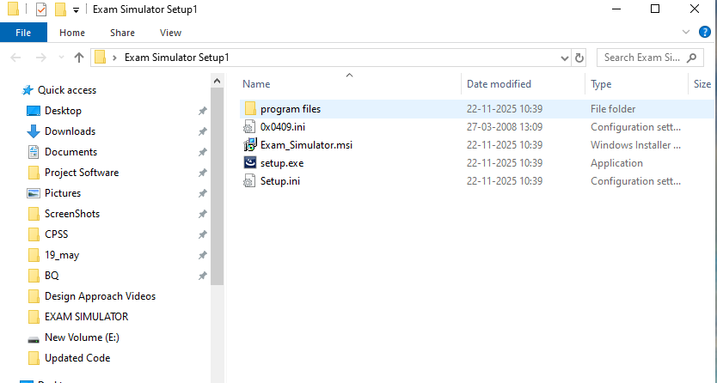
Release and Deployment
Click on→Setup.exe

Slide 32
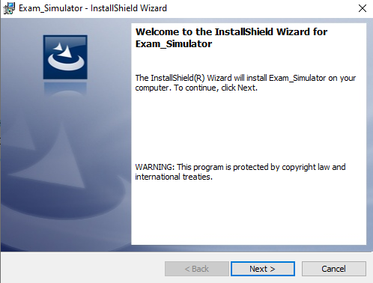
Release and Deployment
Click on → Next

Slide 33
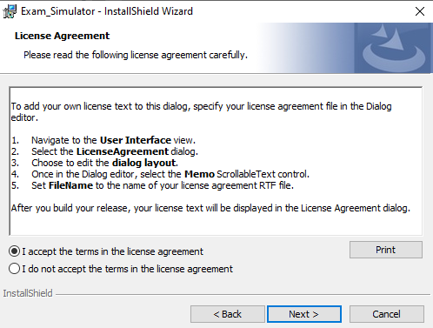
Release and Deployment
Accept the terms and conditions then
Click on → Next

Slide 34
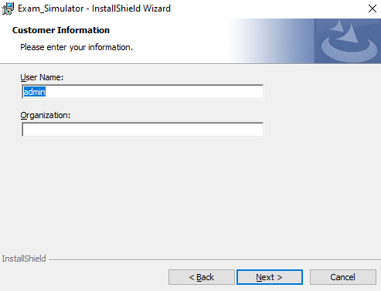
Release and Deployment
Type username then
Click on → Next

Slide 35
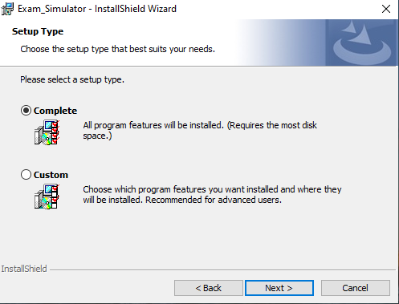
Release and Deployment
Click on → Complete then
Click on →Next

Slide 36
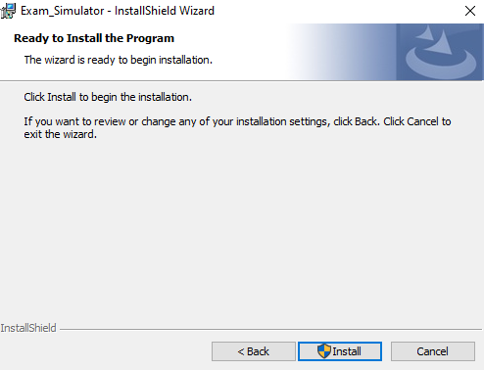
Release and Deployment
Click on →Install

Slide 37
Release and Deployment

Slide 38
Release and Deployment
Click on → Finish

Slide 39
Release and Deployment

Slide 40
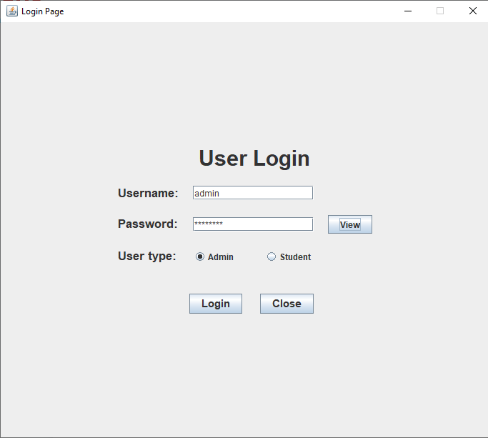
Project Snaps
Admin Login Page

Slide 41
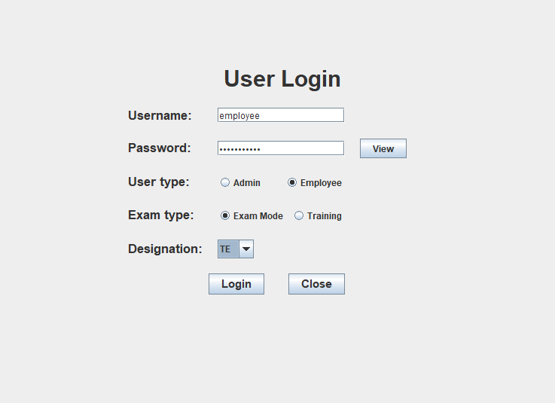
Project Snaps
User Login Page

Slide 42
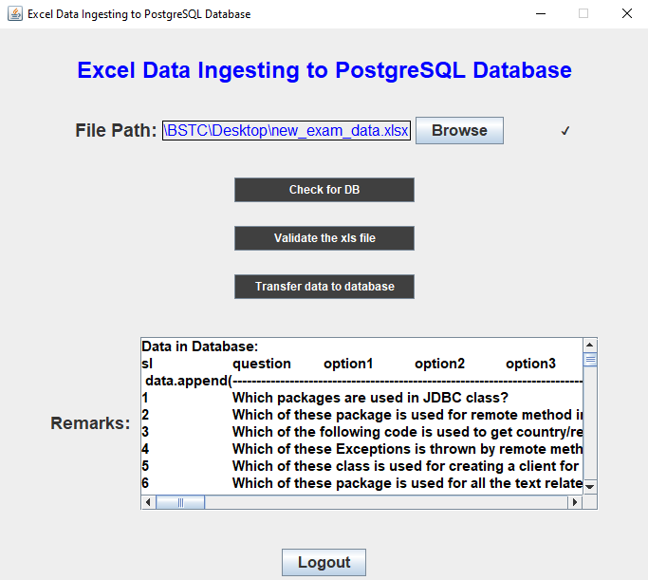
Project Snaps Continue….
Admin → Excel to DB transfer Snap

Slide 43
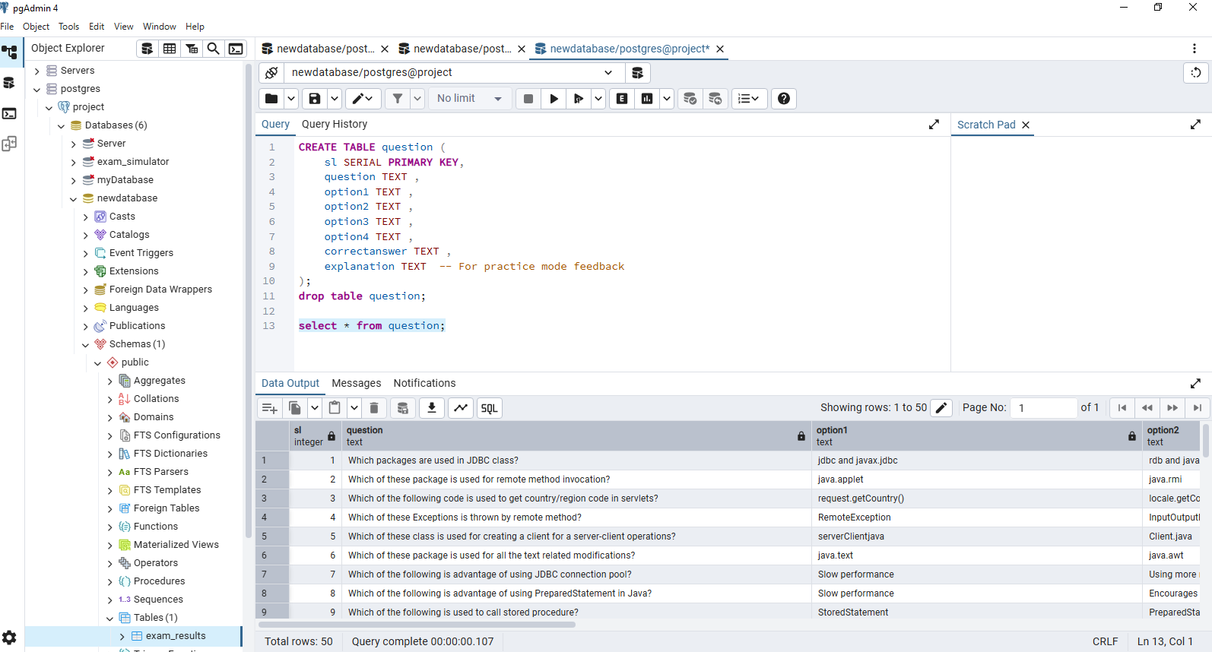
Project Snaps Continue….
Transfer Data Base

Slide 44
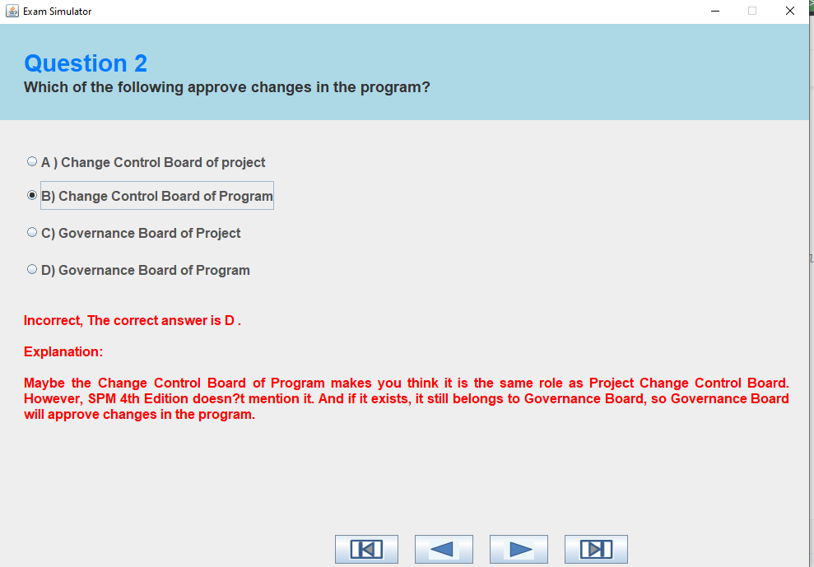
Project Snaps Continue….

Slide 45
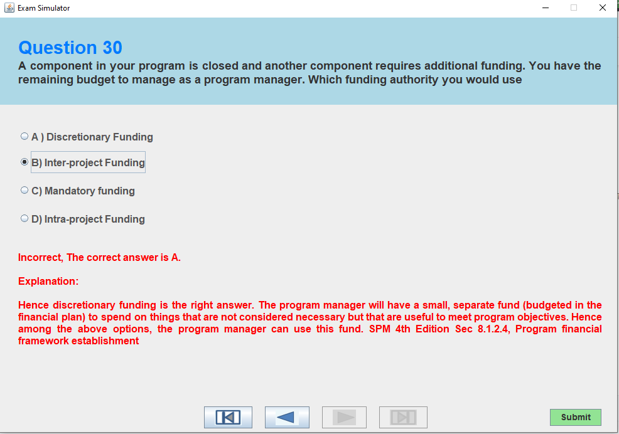
Project Snaps Continue….

Slide 46
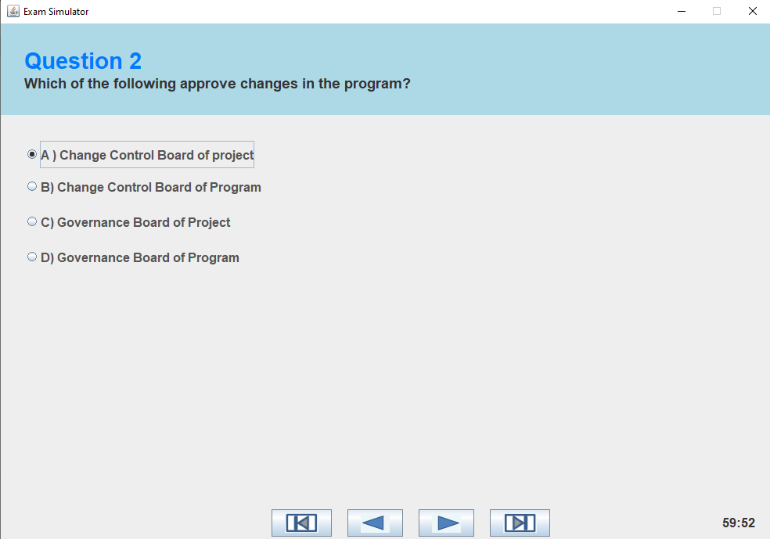
Project Snaps Continue….

Slide 47
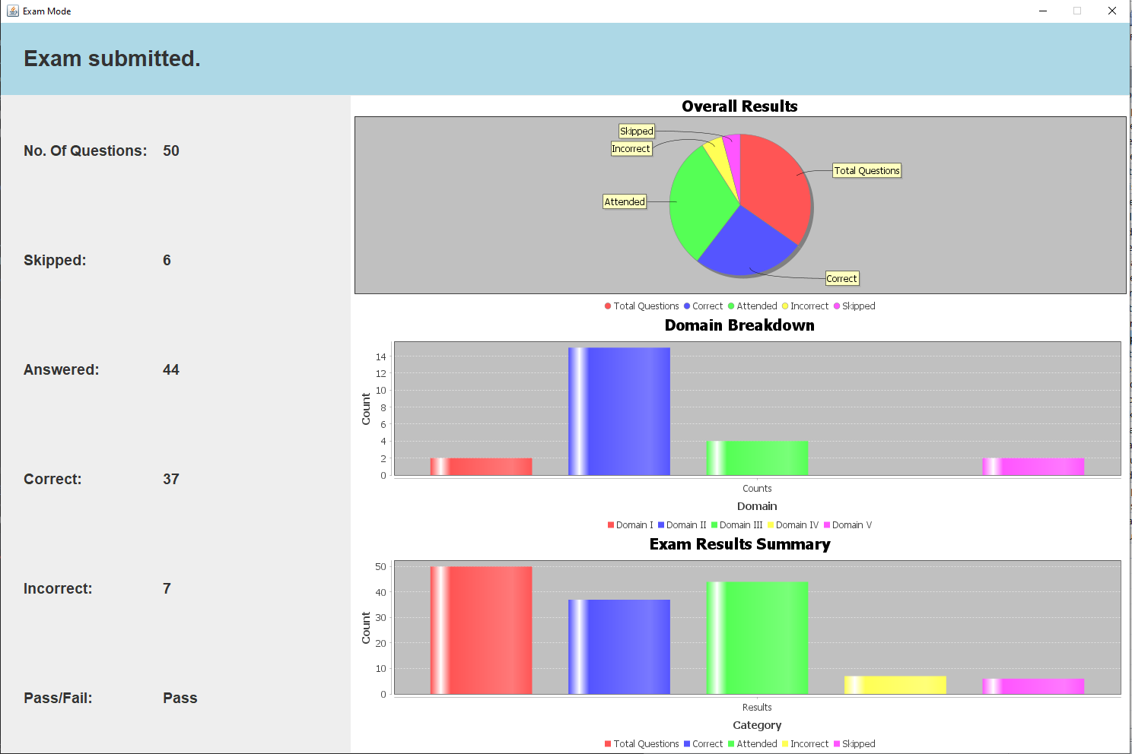
Project Snaps Continue….
Exam Mode Page → Result Page → Pass

Slide 48
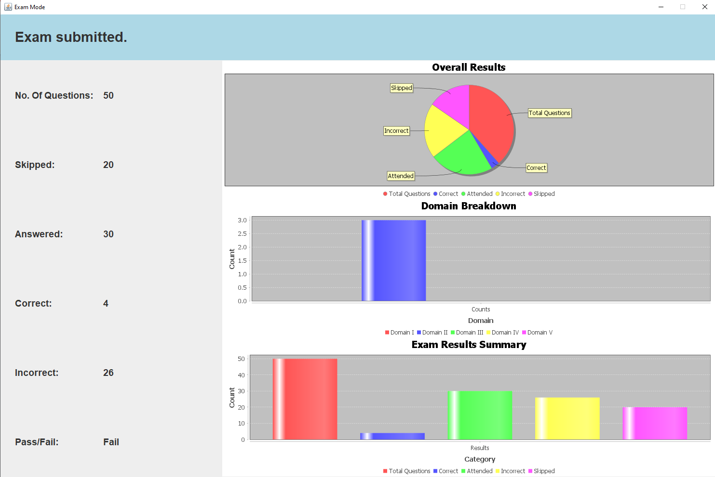
Project Snaps Continue….
Exam Mode Page → Result Page → Fail

Slide 49
SDLC(Waterfall Model)
Waterfall - Software Development Life Cycle (SDLC) Model
Initiation Phase |  | Planning Phase | Execution Phase |  | Monitor & Control Phase |  | Closure Phase
 |  |  | Design | Implementation (Coding)
1). Project Overview 2). Project Abstract |  | 1). Project workout plan 2). Project Requirements 3).Requirement Analysis 4). Software Framework Establishment. 5). Test Plan & test cases. 6). Release & Deployment Plan | 1). Flow Chart 2). Use case diagram 3). Activity diagram 4). Sequence diagram 5). Class diagram 6). Project Design Approach Technique | 1). Source code 2). Test the source code with test case approach. 3). Project integration | 1). Software release or deployed component in test environment. 2). Standard testing using test case Approach. i. Unit Test case Validation ii. Functional qualification testing. |  | 1). Presentation for Project Closure. 2). Feedback From Organization. 3). Document Lesson Learned , Best Practices ,Risks and Issues.

Slide 50
Project Summary
Lessons Learned:
Waterfall Model : Gained a thorough understanding of each phase within the Waterfall development methodology.
Design patterns : Designing class , sequence , use case and activity diagram.
Test Cases: Unit and functional quality test cases creation fundamentally understood.
Requirement Gathering & Analysis: Developed skills in eliciting clear, concise, and testable requirements
Release and Deployment: Learned how to deploy the code into executable file and install the complete application.
Database : Creation of database , creation of tables and importing of files from external source.
Debugging: Gained the ability to identify and fix errors (bugs) in code
Code Organization: Learning to keep code tidy and well-structured.
Code Refactoring: Learned techniques to improve the structure and readability of existing code without changing its functionality.

Slide 51
Project Summary
Risks:
The ingestion process cannot handle increasing volumes of Excel data, hindering future growth.
The system is tightly coupled to a specific Excel format, creating difficulties if the format changes.
If exam content becomes outdated, regular updates are needed.
Multiple admin accessing the application at the same time may lead to lack of integrity.
If the file is improperly formatted wrong column headers, incorrect data types, missing data, it may produce incorrect results.
Excel files can get corrupted or deleted, resulting in the loss of data.
Storage of previously loaded questions in DB may cause mismatch between questions.
The lack of formatted dependency cause the application instability.

Slide 52
Project Summary
Best Practices:
Day to day updation of code and documentation.
Understanding of complete Software Development Life cycle (SDLC) process
Referred videos and documents for reference.
Continuously learning about new technologies.
Actively participate in regular team meetings.
Knowledge sharing and documentation for future reference

Slide 53
Project Summary
Issues:
Excel data doesn't always map cleanly to database types.
Pie chart slices were not accurately reflecting the data proportions
The Excel structure differs from the expected database schema, leading to incorrect data placement or failed ingestion.
Ingestion process doesn't effectively handle duplicate records, resulting in redundant data in the database.
Uploading specific dependency files for various functionalities in code.
Connection of PostgreSql database to the frontend UI.

Slide 54
Future Enhancement
Check for missing or incorrect data before inserting.
Allow seamless integration with LMS .
Multiple subjects can be introduced.
Ensure the application is fully functional and aesthetically pleasing on all devices (desktops, tablets, smartphones).
UI modification can be done.
Importing different file formats.
Enable users to share resources(study material).

Slide 55
Thank You

